Slide 1

Deep Learning
Week 5
Brian Spiering

Slide 2
Learning Objectives
Explain Neural Networks, Deep Neural Networks in your own words.
Describe the parameters and hyper-parameters of deep learning models.
Explain what is a convolutional neural networks (CNNs)
Work through case studies of seminal deep neural architecture applied for computer vision tasks.
Train and test CNNs on real-life applications.

Slide 3
Deep Learning Definition
Deep Learning is part of a broader family of machine learning methods based on artificial neural networks with representation learning (a.k.a. automated feature detection). Deep refers to more than one hidden layer.
https://gfycat.com/gifs/search/neural+network
https://en.wikipedia.org/wiki/Deep_learning

Slide 4
Concepts and Models
-Deep Learning Concepts:
Activation Functions: sigmoid, tanh, relu (and its variants)
Parameters, hyper-parameters:
Learning rate
Epochs
Number of layers
Units per layers,
Activation function
Regularization: L1, L2, data augmentation, early stopping, dropout
-Convolutional Neural Networks for supervised learning

Slide 5
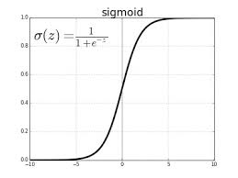
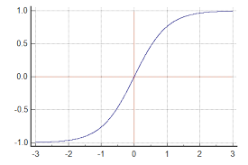
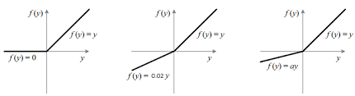
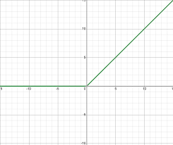
Activation Functions: To induce non-linearity
Sigmoid: Preferred for last layer y=[0,1]
Tanh: Preferred to center outputs at 0. y=[-1,1]
Rectified Linear Unit (ReLu) y in [0,inf]
tanh
ReLU
Leaky ReLU
Parametric ReLU
Concatenated ReLU

Slide 6
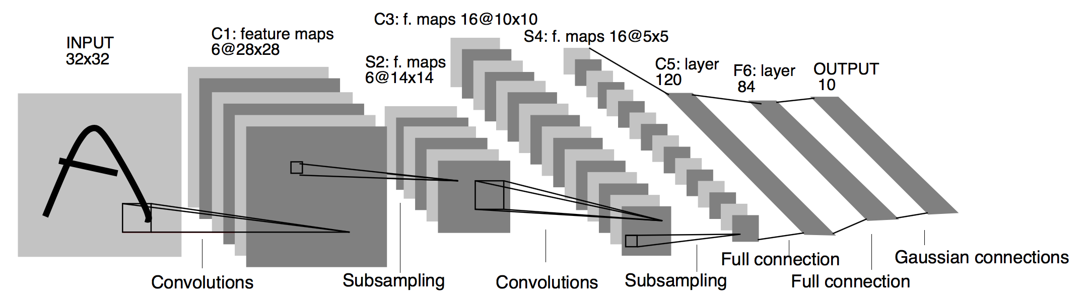
Convolutional Neural Networks
Typically used for image processing/computer vision problems.
Two stages in training: feedforward and back-propagation.
Lenet by Yann LeCun
http://yann.lecun.com/exdb/publis/pdf/lecun-01a.pdf

Slide 7
Live Assignment: Machine Learning @Epic_Software [Aiding Medical Research]

Slide 8
The Problem
You have access to retinal images. Your goal is to perform the following:
A. To create an end-to-end predictive data model that generalizes across patients.
B. To learn regions of interest at various layers.

Slide 9
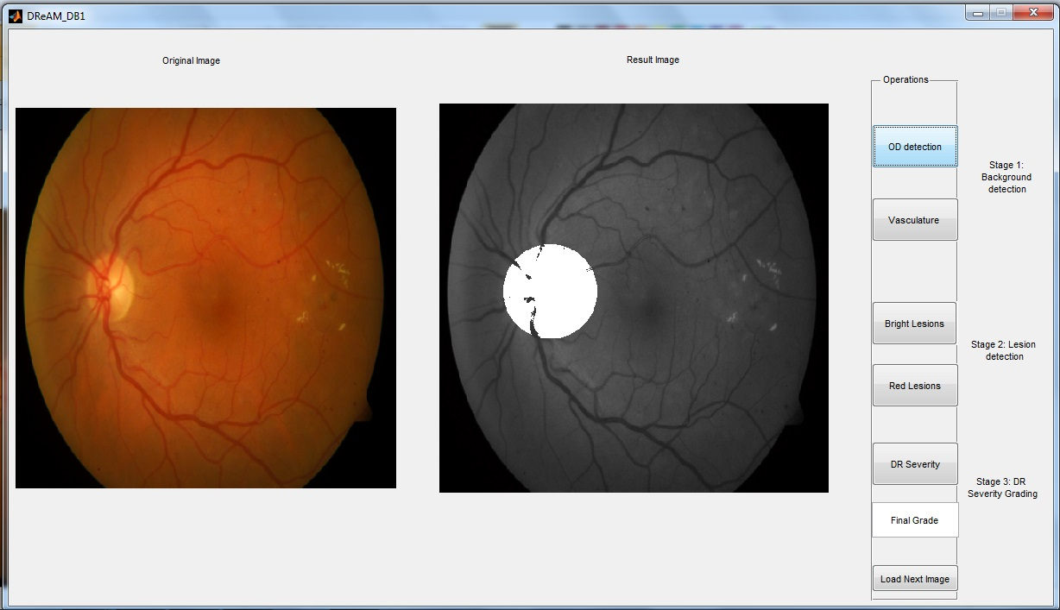
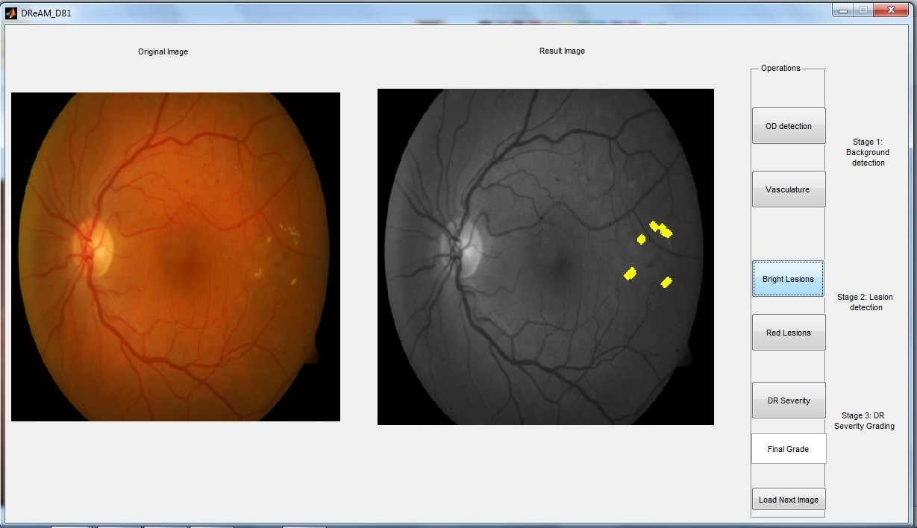
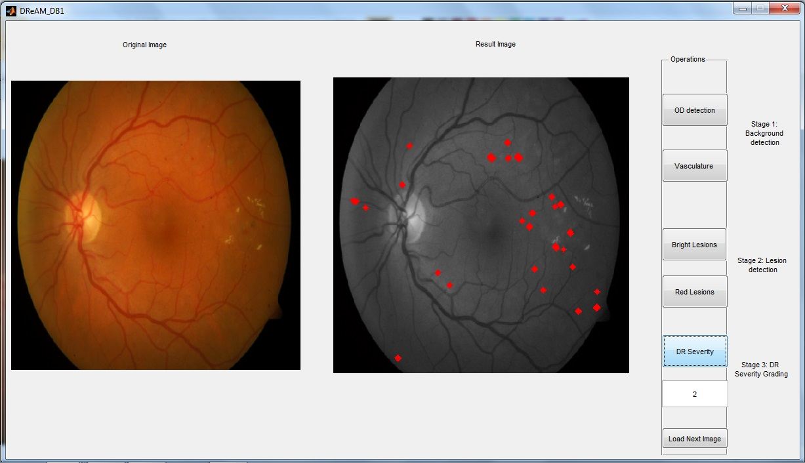
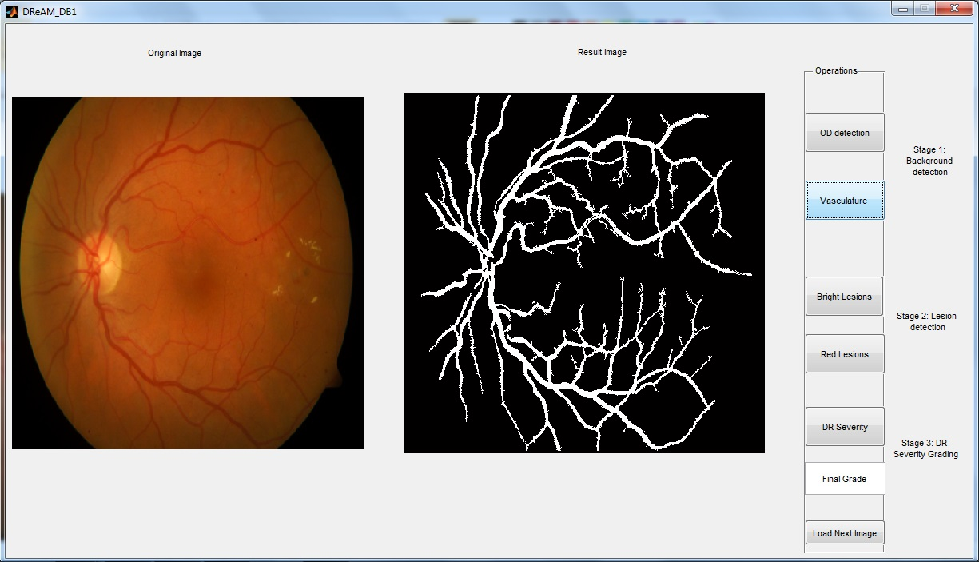
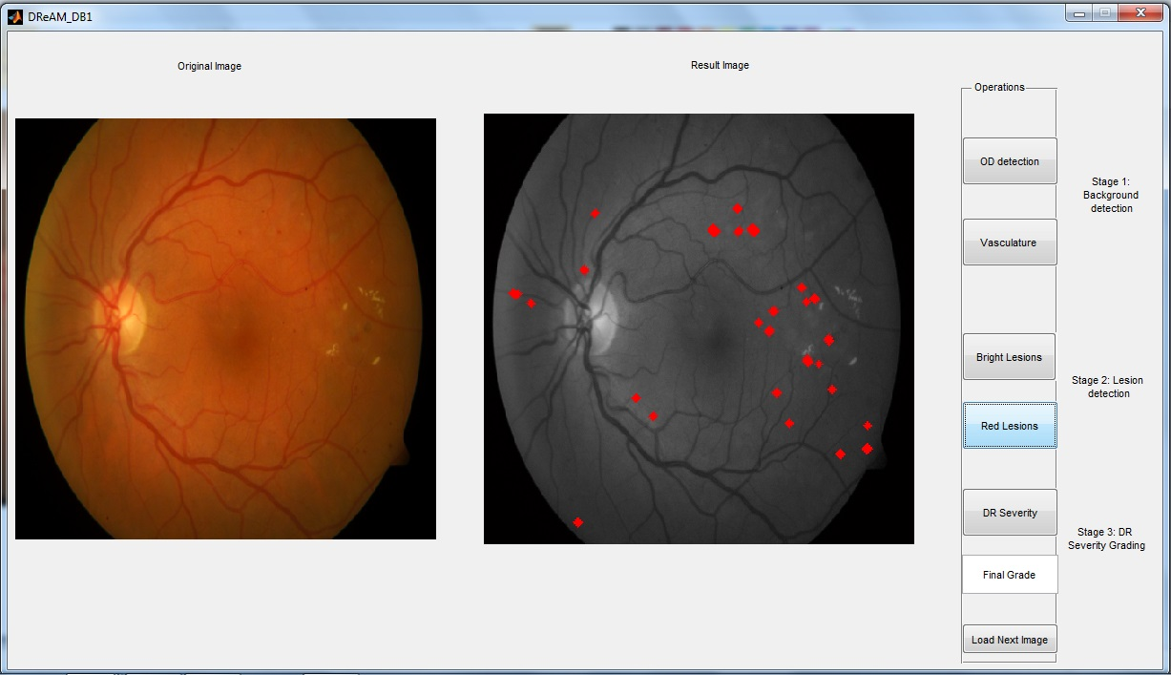
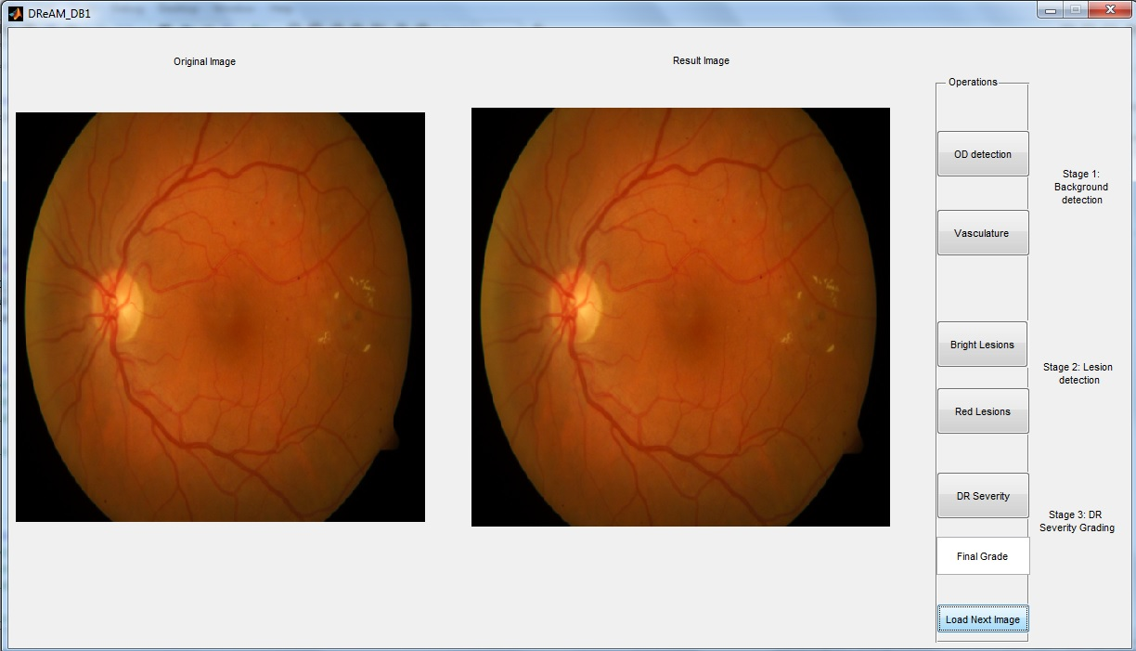
The Problem: Automated Detection of Diabetic Retinopathy

Slide 10
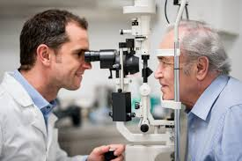
Overall System Design: End-to-end Process
Predictive Data Model
You are here
Data Processing (Cleaning, formatting)
Model Assessment and Feedback
Adds more data
Today’s problem: Finding a generalizable model
Helps prioritize patient care by doctors
Medical Image data storage

